Slide 1
Recipe Recommender
By Manthan Desai

Slide 2
Objective
Develop a robust recipe recommender system leveraging a dataset of recipes and a corresponding dataset of user reviews
Goal: An engine that suggests recipes based on individual preferences, recipe features, and past review history
Potential Challenges:
Data integration
User profiling
Algorithmic efficiency

Slide 3
About the data
Recipes dataset
# of records: 231637, # of fields: 12
No missing values in any relevant columns
Data Wrangling:
The nutrition column was split into 7 individual columns
The tags column was analyzed through NLP to generate ‘is_vegetarian’, ‘is_vegan’, and ‘cuisine’ columns
Categorical columns were created from the minutes, n_steps and n_ingredients columns
User reviews dataset
# of records: 1132367, # of fields: 4
Data was already clean with no missing values

Slide 4
Exploratory Data Analysis
A visual look at the datasets and the relevant features

Slide 5
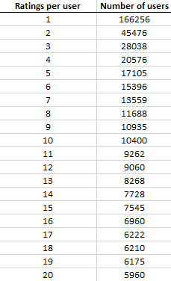
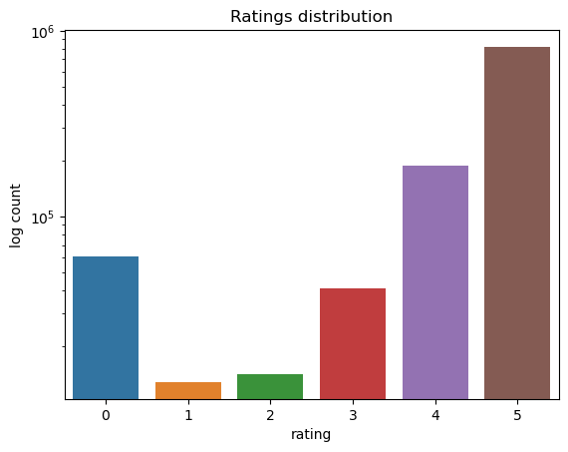
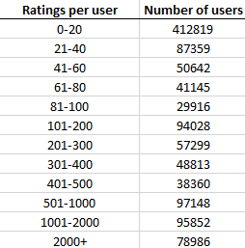
Preliminary Observations
Recipes are mostly rated 4 or 5
Heavy percentage of users have 1 recipe review which highlights the need to solve the cold start problem

Slide 6
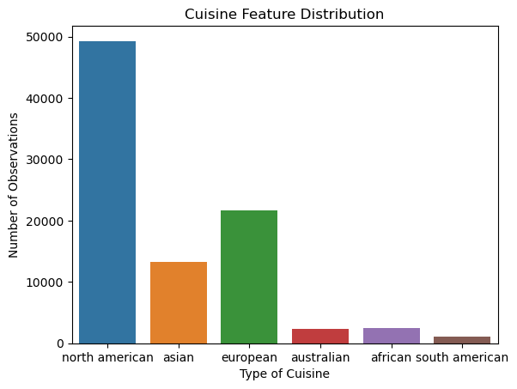
Feature Highlight: Cuisine
Using NLP methods, the tags attribute in the raw recipe dataset was mined for the type of cuisine in each recipe
Most prominent cuisine types:
North American
European
Asian

Slide 7
Modeling
Methodology and results

Slide 8
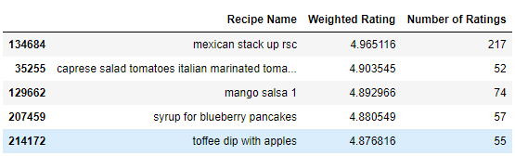
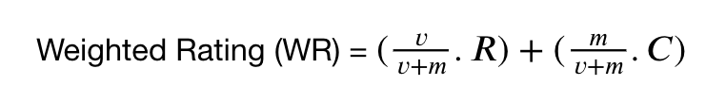
The simple recommender
Determines and returns the top n recipes as rated by all users
Uses the IMDB weighted rating formula to calculate a composite score for all recipes
Drawbacks:
Does not consider individual user preference
Does not consider recipe attributes

Slide 9
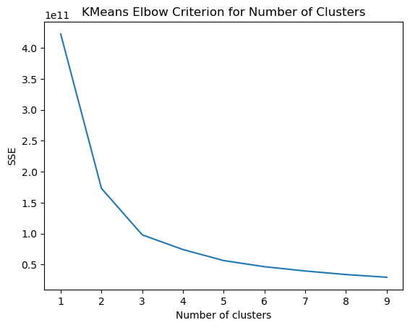
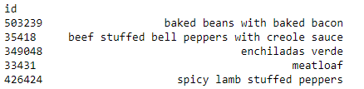
The content-based recommender
Finds the top n most similar recipes to a given recipe
Uses k-means to assign each recipe to one of 4 clusters, then finds the n closest recipes to the input recipe in the appropriate cluster
Drawback: User preference is not considered

Slide 10
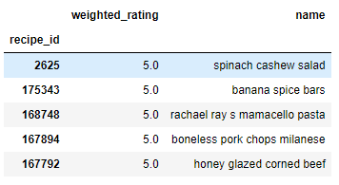
The hybrid recommender
Given a user, the system finds the most similar users through correlation and computes a weighted rating for the list of recipes reviewed by the similar users
If no similar users are found based on the correlation criteria, the system assigns a content recommendation based on the input user’s most highly rated recipe.

Slide 11
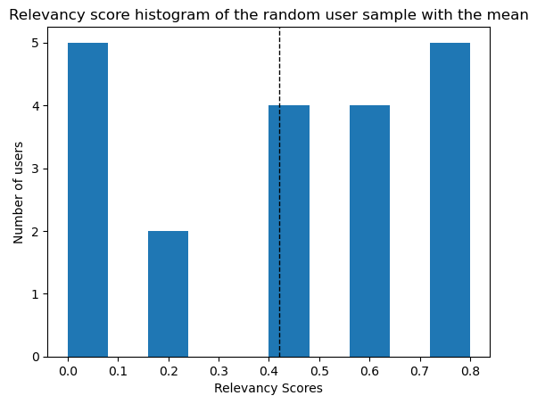
Model Performance
Methodology:
Generate a random sample of 30 users and their latest recipe reviews
Manually assess the relevancy of the recommendations against their latest recipe viewed
Results:
The mean relevancy score 0.42
On average, 2 out of 5 recommended recipes were relevant.

Slide 12

Conclusions
The main recommendation engine uses the following types:
Simple: Top-n rated recipes by all users
Content: Top-n closest recipes to a given recipe
Hybrid: Top-n closest recipes reviewed by users most similar to a given user’s recipe history
In lieu of established performance metrics, model performance was manually assessed to find 2/5 recommendations relevant for each user in a random sample of 20
To improve recommender performance, more features could be extracted from the data such as recipe type (appetizer, entrée, etc), and the ingredients can be analyzed further
Ultimately, the data dictates the model performance therefore better datasets, particularly one that provides more metadata about the users would be the best way to improve performance.

